Slide 1
Understanding and Optimizing Software Delivery
The Technology
Value Stream
Melissa Lawrence
CSD 380 Assignment 1.2

Slide 2
Contents
Introduction to Value Steam
Lead Time vs Processing Time
Lead Time Deployment Requiring Months
Lead Time Deployment in minutes
DevOps Ideal
Strategies to Reduce Lead Time
Conclusion
References

Slide 3

A value stream is the sequence of activities required to deliver a product or service to the customer
Introduction to Value Stream
identify inefficiencies and optimize processes to deliver value faster

Slide 4


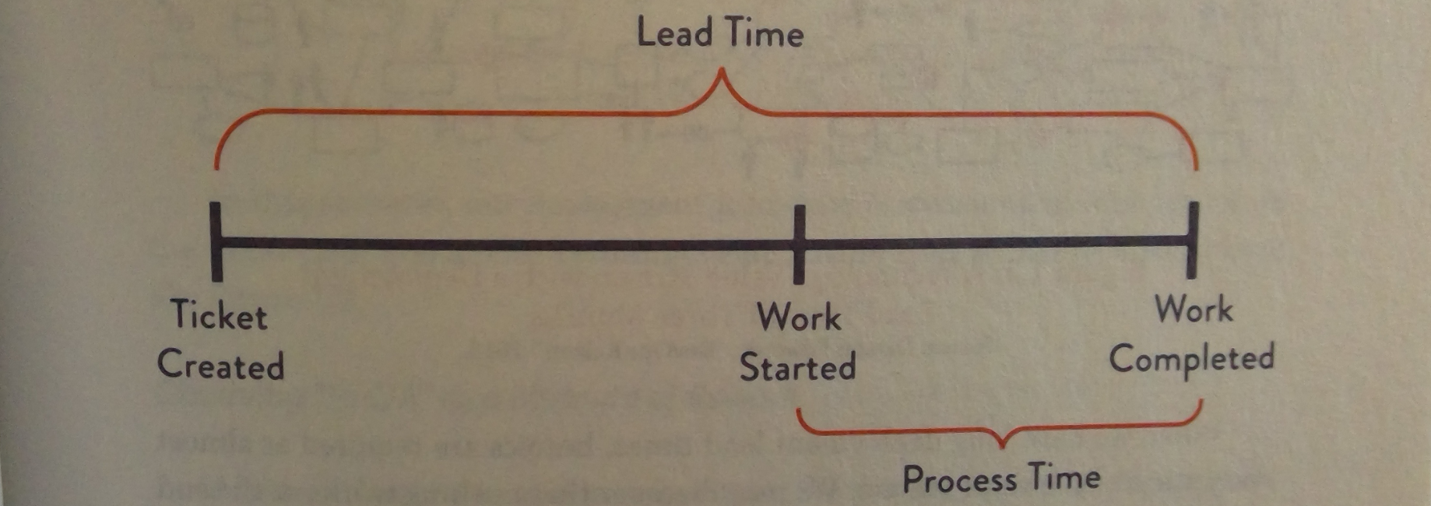
Lead Time: The total time from the initiation of a process to its completion.
Processing Time: The actual time spent working on a task.
Lead Time vs. Processing Time
From Chapter 1: The DevOps Handbook

Slide 5

Lead Time Deployment Requiring Months
Issues:
Customers Experience Lead Time, Not Just Process Time: The total time from start to finish is what impacts customer satisfaction, not just the active work periods.
Project Problems Causing Extensions: Unforeseen issues often extend lead times.
Bottlenecks/Poor Collaboration: Inefficient handoffs and isolated teams create delays.
Impact:
Delay of Project and Feedback: Prolonged lead times delay delivery and feedback loops.
Longer Cycles Mean Increasing Chances of Issues: More changes per deployment can lead to increased risk of errors.
Lower Customer Satisfaction: Delays frustrate customers who expect timely updates.
Team Frustration: Continuous delays can demoralize the team.

Slide 6

Lead Time Deployment in minutes
Commit Stage
10 Minutes
Analyze and optimize the flow of activities required to deliver a product
Automated Test
10 Minutes
Benefits
Instant Feedback: Rapid response to changes
Swift Deployment: Seamless updates and releases
Enhanced Customer Satisfaction: Boosting user experience and trust
Exploratory Test
5 Minutes
Product Deployment
Example Total Cycle: 25 Minutes

Slide 7
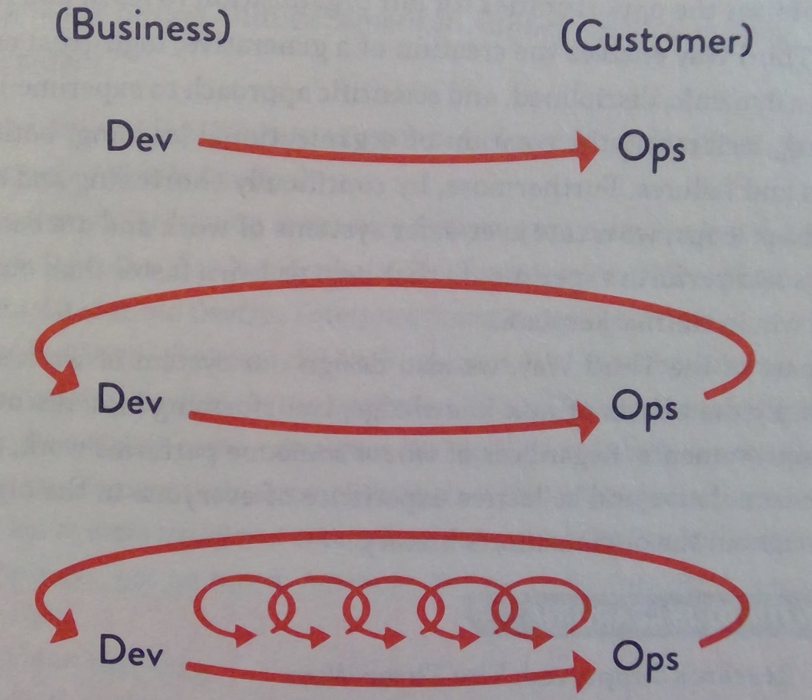
Achieving Deployment in minutes
DevOps Ideal
In an ideal DevOps environment, the focus is on achieving rapid deployment lead times, where changes and updates are deployed seamlessly and efficiently, often within minutes.
By creating more feedback loops successes and failures are quickly identified and addressed, leading to continuous improvement.
From Chapter 1: The DevOps Handbook

Slide 8

Strategies to Reduce Lead Time
Track Key Metrics: Measure lead time, deployment frequency, change failure rate, and mean time to recovery to identify bottlenecks and areas for improvement.
Frequent Deployments: Increase the frequency of deployments to catch issues early and deliver updates quickly.
Automation: Implement automation in testing, deployment, and monitoring to reduce manual tasks and errors, ensuring code quality.
Collaboration: Foster collaboration between development and operations teams to streamline workflows and improve efficiency.
Feedback Loops: Establish continuous feedback loops to quickly address successes and failures, leading to ongoing improvement.

Slide 9

Conclusion
Lead time is what the customer experiences; focusing on process improvements to enhance overall satisfaction and efficiency.

Slide 10
References
Hall, T. (n.d.). DevOps metrics. Retrieved on oct. 24, 2024 from https://www.atlassian.com/devops/frameworks/devops-metrics
Metridev. (Apr 10, 2024). Lead time in DevOps: A key to efficient software delivery. Retrieved from https://www.metridev.com/metrics/lead-time-in-devops-a-key-to-efficient-software-delivery/
Kim, G., Humble, J., Debois, P., & Willis, J. (2016). The DevOps Handbook: How to Create World-Class Agility, Reliability, and Security in Technology Organizations. IT Revolution Press.

